Slide 1
A Social Media-Based Decision Support System:
Can We Tame Uncertainty?

Slide 2
Overview
Lab experiment using virtual environment
Scenario designed to investigate:
Use of Apollo as a decision support system for team/multi-team systems
Compare various configurations of Apollo in use contexts
Evaluate use of VBS2 as a testbed for use of Apollo

Slide 3
Design
Lab experiment that tests the use of Apollo as decision support in simulated field conditions
Simulation using Virtual Battlespace 2 (VBS2)
6 participants form a squad (MTS) comprised of 3 teams of 2 (2 field teams; 1 analyst team)
The squad will complete two missions located in simulated Baghdad that require them to navigate a course with hazards

Slide 4
Design
Three Conditions:
Basic Information Support (Spreadsheet of Tweets)
Textual Support (Apollo List Interface)
Map Enhanced Support (Apollo Map Interface)
Repeated measures design: Two runs through mission (evaluate learning; enhance team training)
Task: High information processing requirements; High coordination requirements; High urgency

Slide 5
DSS Variants
Dimension | Control (Spreadsheet) | Apollo List | Apollo Map-Enhanced
Basic Description | List of 5000 tweets; XCEL spreadsheet with typical sort and search capabilities; highest information processing requirements | Ranked Tweets; List; Search and sort; moderate information processing requirements | Tweets associated with geographical location; lowest information processing requirements
Information Richness | Low | Moderate | High
Restrictiveness/ Guidance | Low/Informative | Moderate/Suggestive~Informative | High/Suggestive
Level | 1 | 2 | 2

Slide 6
Design
Teams will navigate one of two routes through the scenario map during each mission
After the completion of their first mission teams will switch which route they navigate

Slide 7
Information Conditions
Basic
Conventional tweet sorting
Apollo List
Tweets ranked using Apollo according to their perceived credibility
Map-Enhanced Apollo
Tweets ranked using Apollo with the addition of an interactive map interface allowing each tweet to be geospatially located

Slide 8
VBS2
Virtual Battlespace 2
Customizable military simulation environment
Produced by Bohemia Interactive in collaboration with United States Marine Corps and Australian Defense Force
Players navigate terrain by foot or vehicle
Communicate using radio headsets and CRN radio

Slide 9
Scenario
Enemy insurgents have been located at Baghdad airport
Two military units must eliminate these insurgents
Navigate quickly, safely, and neutralize insurgents
A hazardous route

Slide 10
Scenario
Along each route many hazards are present:
Road blocks
Rocket fire
Ambushes
Etc.

Slide 11
Scenario

Slide 12
Scenario

Slide 13
Scenario

Slide 14
Tweet Stream
Apollo was used to collect tweets made in Baghdad following recent attack
5517 tweets were collected
2546 are unique after merging retweets
Apollo was used to rank tweets by credibility and relevance
Top 32 (by rank) are displayed to analyst
16 are relevant to the scenario
16 are “noise” (about other events in Baghdad
8 contain explicit information regarding hazards that are simulated in the experiment

Slide 15
Tweet Stream

Slide 16
Control Interface
Control Condition:
Basic Twitter interface pre-loaded with scenario tweets
Interface allows basic searching and navigation
No tweet ranking or advanced filtering

Slide 17
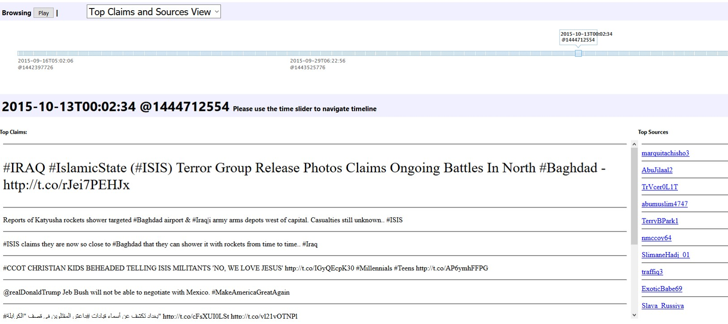
Apollo Interfaces
Apollo List Condition:
Tweets are ranked on source credibility
Information is isolated as graphics and media content are removed
Analyst has the ability to sort tweets

Slide 18
Apollo Interfaces
Map-Enhanced Apollo Condition:
Tweets are ranked on source credibility
Tweets are overlaid on a map of Baghdad using the tweet’s geolocation
Analyst has the ability to isolate geospatially relevant information

Slide 19
Questions and Feedback
Marshall Scott Poole
mspoole@Illinois.edu
Alex Yahja
alexy@Illinois.edu
Jeffrey Proulx
proulx2@Illinois.edu
Tarek Abdelzaher
zaher@Illinois.edu

